Slide 1
Event Storming
or How I learned to stop worrying and love requirement meetings

Slide 2
Goal
To give an introduction into Domain Driven Design using an interactive Event Storming exercise

Slide 3
What is Domain Driven Design?
DDD is “primarily about modeling a Ubiquitous Language in an explicitly Bounded Context”
(From Domain Driven Design Distilled, Vernon 2016)
Specifically it is of set of patterns and practices producing and interacting with a Domain Model at a Strategic and Tactical level
Notes:
Strategic is the 10000 feet while Tactical Patterns inhabit the code level

Slide 4
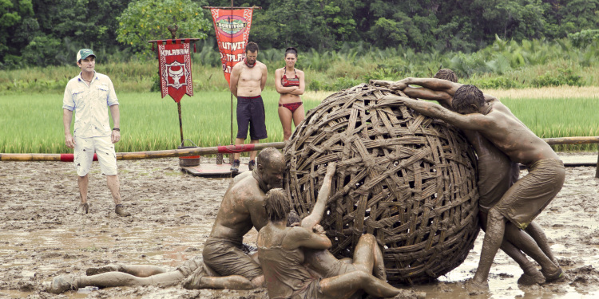
Also a means to prevent
Notes:
This is a big ball of mud. It usually consists of a monlithic legacy app. Give VS example

Slide 5
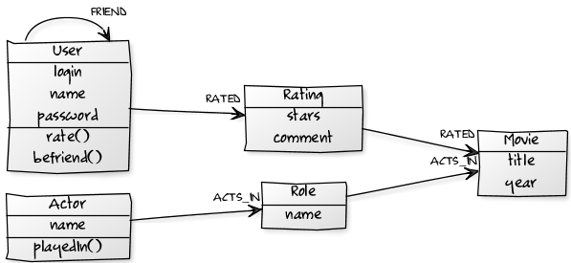
The Domain Model
Notes:
Domain model is a model, in software form, of some real world construct. Model consists of business logic, leaving UI and Infrastructure concerns to other types.

Slide 6
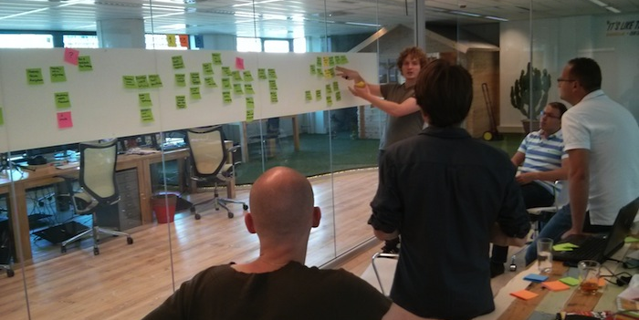
Storming to a Model
Notes:
Event storming is a modeling exercise designed to bring the development team and outside domain experts together
Focuses on process discovery over entities
Goal is to produce a rough domain model to be used in development

Slide 7

Car Simulator
We will be designing a driving game that will work with VR devices.
Players will be able to drive, design, buy and sell new and used cars, and interact with other players

Slide 8
The First MMF
Provide a realistic driving experience in ideal weather conditions
Driving will result in normal wear and tear on the vehicle
A standard set of cars can be bought and sold in the market place with limited customizations
Used cars can be sold to other players at the seller’s price

Slide 9
Roles
Developers: Members of the team developing the system
Domain Experts: Members of the team with expert knowledge in all or part of a given domain
You, the audience, will serve as both Domain Experts and Developers
I will serve as facilitator and Product Owner for this exercise

Slide 10

Domain Events
An important event in the context of the Domain
Internal and external processes will then consume these events when fired

Slide 11

Step #1: Identifying the Domain Events
For review, Domain Events are an important event within a Bounded Context
Place Domain Events in chronological order on a sticky note
Concurrent events happen on same vertical plane
Written with a past tense verb
Use lilac color sticky notes to denote processes happening from events
Notes:
20 minutes for this exercise
Start by placing three domain events onto the paper

Slide 12

Step #2: Identifying the Cause
Identify the Command that caused each Domain Event
Place directly to the left of the Domain Event
Specific Roles are written on a bright yellow sticky in the lower left corner of the command
Processes that are kicked off by Commands are written on Lilac colored sticky notes
Notes:
15 minutes
If specific role write on a small yellow sticky
Processes that are kicked off will be placed on a lilac sticky note

Slide 13

Step #3: Who did it?
Identify the associated Entity (Aggregate) to each Command/Event pair
Place it behind the pair
Note common Entities without rearranging them
Notes:
15 minutes

Slide 14
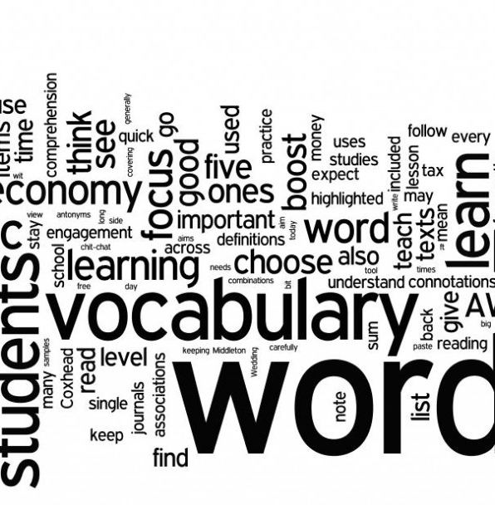
A Shared Language
Words may have different meanings depending on perspective
Ubiquitous Language is a shared language within the Bounded Context agreed to by the team

Slide 15
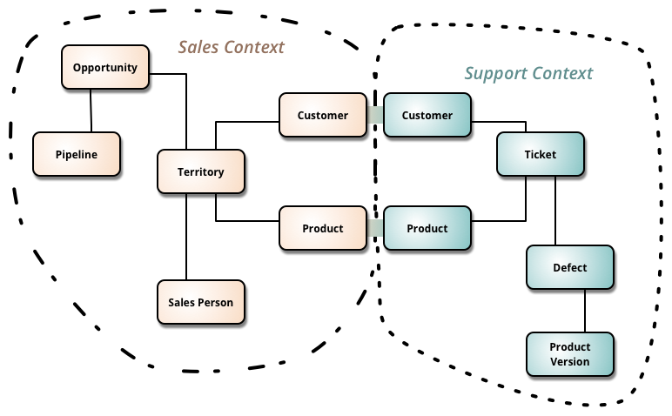
Language in a Context
A bounded context is a linguistic boundary around Ubiquitous Language
Like concepts go together while foreign concepts are outside

Slide 16
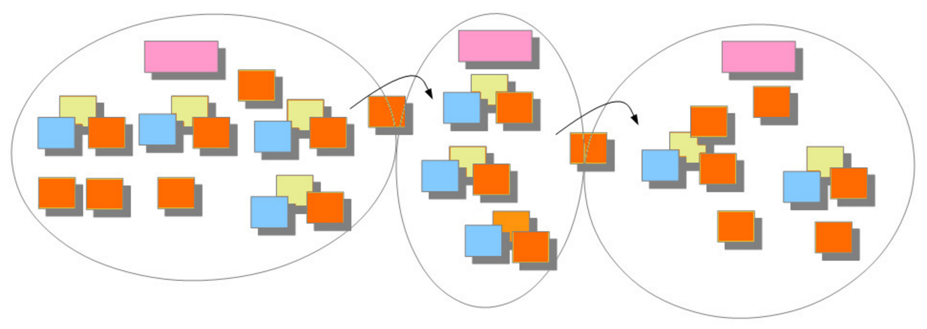
Step #4: The Dividing Line
Look for divisions in the model to identify Bounded Contexts
Draw solid lines for Bounded Contexts and dashed Lines for subdomains
Use Pink Sticky Notes to name the Bounded Contexts
Draw arrows to show the flow of information across Contexts
Notes:
I will do

Slide 17

Step #5: What do we see?
Identify any Views and put them within each Bounded Context
Role specific Views have a bright yellow sticky with the Role
If necessary, draw a quick mock up of the View

Slide 18
Event Storming Review
Produced a Domain Model by focusing on the Events, Command, and Entities
Split that model into different contexts based on language differences
Question remains: What should we work on first?

Slide 19
Types of Bounded Contexts
Core Domain: The core of the initiative that brings in the most value. This will get the most attention and resources. This will be the focus of development.
Supporting Subdomain: A subdomain critical to the effort and still provides value. Usually will be developed in house.
Generic Subdomain: Domain that doesn’t provide much value but still ticks a box of some sort.

Slide 20

Focusing on the Core
Focus on developing the driving portion first, which is the Core Domain
Supporting Subdomains and Generic Domains may be bought or have less time spent
Notes:
Give authentication and security as Generic Subdomain examples. These are solved problems.

Slide 21
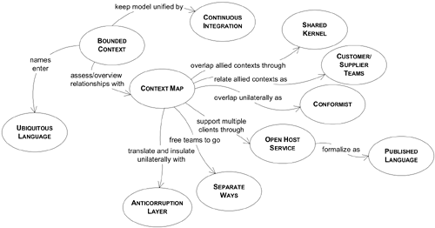
Strategic Patterns Visualized

Slide 22
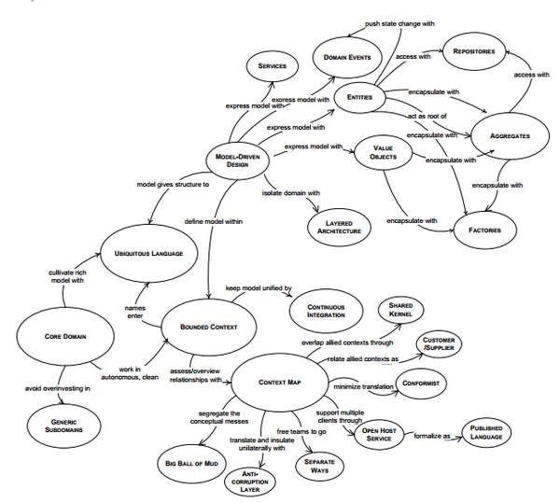
Completing the Picture

Slide 23
Interesting Books and People
Original DDD Book by Eric Evans
Implementing DDD by Vaughn Vernon
Domain Driven Design Distilled by Vaughn Vernon
Julie Lerman: Blogs about DDD with Pluralsight course
Jimmy Bogart: Blogs about DDD
Udi Dahan: CQRS and blogs about DDD
Greg Young: CQRS
Many, many more

Slide 24
About me
Presentation out on Github: https://github.com/rattrapdev-public/public-files
Email: mateo6379@gmail.com
Twitter: @rattrap79

